Slide 1
What do I do With It?
Christopher Norton
COMM 1020.009
November 16, 2011

Slide 2
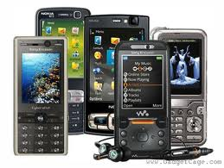
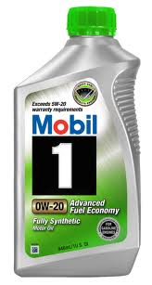
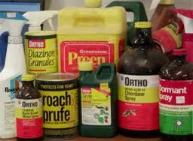
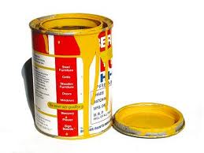
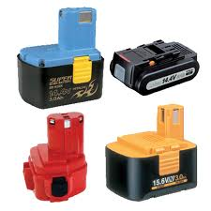
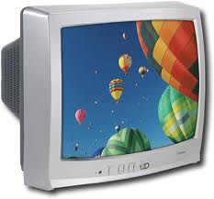
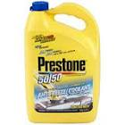
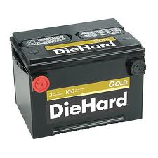
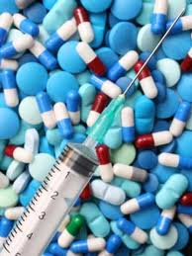
Different Wastes
Household Hazardous Waste (HHW)
Medications
Prescription
Medical Needles
E-Waste
CRT Televisions / Monitors
Batteries
Cell Phones

Slide 3
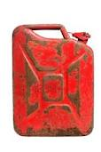
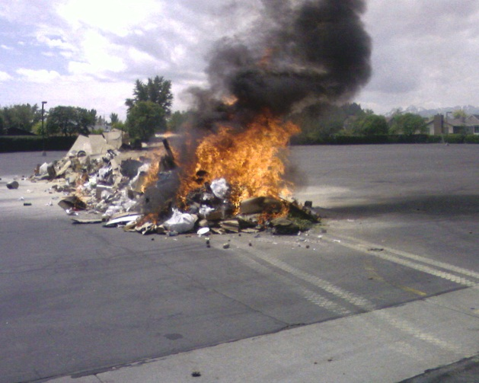
Consequences
So what if I mix these things in the same garbage can?
+
=

Slide 4
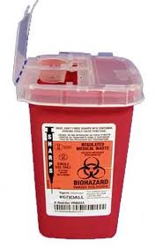
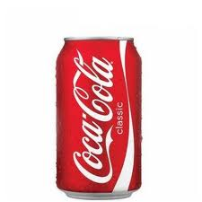
Where ? How?
HHW
Oils, Antifreeze, Car Batteries
Paints, Solvents
Power Tool batteries
Medical Waste
Rx
Needles
E-Waste
Consumer Electronics Stores
HHW centers @ Landfills

