Slide 1
Christopher Norton
Communications 1120.001
Spring 2012

Slide 2
“Exert your talents, and distinguish yourself, and don't think of retiring from the world, until the world will be sorry that you retire.”
-Samuel Johnson
Hi! My name is Christopher Norton and I make things happen.
I am a very driven individual that has made the most of every employment opportunity that I have had. I believe that it really doesn’t matter what job you have, satisfaction can be found in doing a job well and to the best of your ability.

Slide 3
Driven…
I enjoy competing in team sports. By being a member of a team you learn teamwork , drive, and competition.
I am extremely competitive and driven to succeed.
Whether it is competing with a fellow employee or with myself, I find that in order to progress you need to stretch yourself to do better.
I am constantly looking for better ways to make the industry in which I work more productive and profitable. Whether it is through better sequencing or major routing changes, I have helped increase productivity for the companies I have worked for.

Slide 4
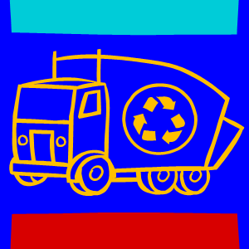
Ethical / Responsible…
I firmly believe in living by a strict code of ethics. We all have a responsibility to ourselves and each other to live ethically.
In order to operate in the waste industry ethically, you must obey and follow laws from numerous varying government agencies such as: the Department of Transportation (DOT), Federal Motor Carrier Safety Administration (FMCSA), Occupational Health and Safety Administration (OSHA),and the Environmental Protection Agency (EPA).
In addition to operating under these laws and policies, ethical operation in the waste management industry also involves providing sustainable solutions for the recycling needs of your customers and the public that you serve.

Slide 5
Hands on….
I prefer to lead by example - to be among those I supervise and encourage them to do what is right for themselves and the company.
I have trained and coached drivers for the past 12 years on the proper procedures of driving our trucks safely. If training is not done right in this industry, sometimes you don’t get a second chance.
I have researched and recommended many ideas to my current and past employers. These suggestions have been implemented companywide in many cases.

Slide 6
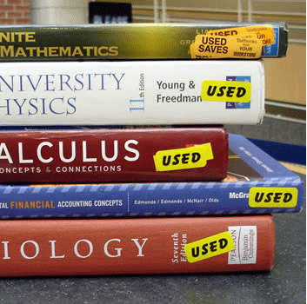
Dedicated…
I want to continue to improve my knowledge of business and leadership in order to become a better asset to whatever company I work for.
I have been greatly influenced by my family to continue learning. I want my kids to see that education - in all of its forms - is important to me.
“Energy and persistence conquer all things.”
-Benjamin Franklin

