Slide 1
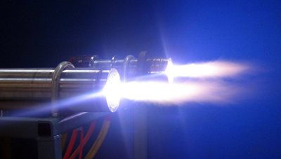
A Ray of Hope?
Plasma Gasification and the Future of Waste

Slide 2
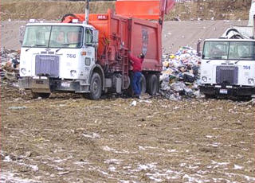
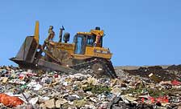
Waste Not, Want Not.
4,000 tons of trash is taken to the two landfills in Salt Lake County every day.
Over the past 30 years, the National average of waste per person has increased from 3.6 pound s a day to 4.5 pounds per day.
Landfill space is disappearing at an alarming rate. Within 50 years the Salt Lake County landfill will be full and there is no plans for a new one.

Slide 3
Where does all this waste go?
Recycling centers – Materials collected from curbside recycling programs throughout Salt Lake County go here.
Material Recovery Facility (MRF) – This is a facility where trash is dumped and it is later separated by hand to recover recyclable materials. Most of the commercial trash in SL County is taken to one of these.
Landfills –Trash is taken here to die. Most of the curbside waste from the cities in SL County is taken to a landfill.
Incinerators – Can burn trash to create heat and power. There are currently no incinerators in SL County.

Slide 4
What Does the Future Hold?
The SL County landfill has less than 50 years left of capacity. There is not another site to replace the landfill.
At 33 % nationally, recycling participation is higher than it has ever been. Here in Utah the percentage is nearly ½ of the national average.
Nearly 70 % of all waste can be recycled. What can be done with the rest?

Slide 5
Who Cares If We Recycle
Waste per Person
(steady increase assumed)
Year | Pounds per Day | Pounds Per Year | Recycling 70% of Waste
1980 | 3.6 | 1314 | 394
2010 | 4.5 | 1643 | 493
2040 | 5.625 | 2053 | 616
2070 | 7.03125 | 2566 | 770
2100 | 8.7890625 | 3208 | 962
If recycling was used to its fullest extent, we could cut the average yearly waste stream by 70%.

Slide 6
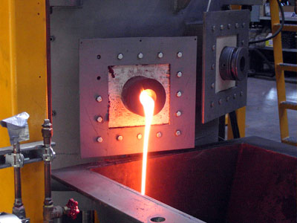
Plasma Gasification
In plasma gasification, preprocessed waste is fed into the gasification chamber from a hopper. Once inside the gasification chamber, the waste is hit with an electrical arc that can be as hot as 30,000 °F. At this extremely high heat, materials are reduced to their basic elements of hydrogen, carbon, and oxygen.
The gases that are formed from this process are collected and processed by a series of afterburners and filters to produce saleable products. Including electricity, diesel fuel, ethanol, and pipeline quality natural gas.
The solids that are left are turned into a molten slag that can also be used to create saleable products.

Slide 7
Gasification Cycle
Waste is crushed into smaller pieces
Waste is fed into gasification chamber
Plasma arc is used to break down waste.
Gases and slag are collected and processed for resale
Electricity and Syngas from the process can be used to run the plant.
Excess electricity can be sold back to the grid for use by the community.
Metal can be salvaged from the molten slag and recycled.

Slide 8
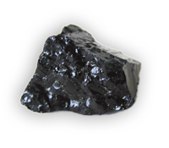
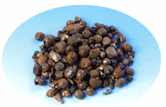
By-Products
Gases
Molten Slag
Synthesis Gas – Syngas after being burned and processed can be used to create electricity, natural gas, diesel, ethanol, or Hydrogen for vehicles.
Metal tailings can be separated from the remainder of the slag during cooling.
The remainder is an obsidian-like substance that can be re-melted to form building tiles, or ground up to be used as road material.

Slide 9
Pros and Cons to Gasification Plants
Pros
cons
Can handle all kinds of waste, including medical waste and concrete
Self sustaining, can produce all the power and fuel needed to run itself
Excess products can be sold for profit
Can be used to reclaim decades of trash that has been dumped at landfills, thus freeing up valuable space and beautifying the community
The only drain from community power resources is the initial fire up of the plant (this is about the equivalent of a police stun gun)
Emissions levels are still high; more research is needed to bring them down
With a plant that can handle and recycle anything, many worry that reducing and reusing will be neglected
Cost: a plant that is big enough to handle the waste generated in SL County would cost $450 million dollars. With tipping fees and the sale of recyclable by-products a profit would not be seen for a decade.
Repairs to gasification facilities are costly and time consuming.
Tipping fees and land are still relatively cheap. Making it so that the environmental reasons don’t out weigh the economical reasons.

Slide 10
The Solution
Reduce
Reuse
Recycle
Gasify
Reclaim
The solution to the waste dilemma needs to be a strong recycling program and continued research in the field of plasma gasification. When this technology becomes more economical and reliable enough to handle the necessary volume; then, along with a strong recycling program, we can begin to turn trash into power and begin to reclaim existing landfills.

Slide 11
Additional Information
Research Paper by
Chris Norton

Slide 12
Sources
“The Prophet of Garbage” Popular Science. Michael Behar. March 1, 2006. Web November 16, 2009 www.popsci.com/popsci/science/873aae7bf86c0110vgnvcm1000004eecbccdrcrd.html
This is a good resource for explanation about the different plasma converters and how they work. This main focus of this article is StarTech Industries. The author provides good numbers for average tonnage processed and cost of facilities to handle that tonnage.
“How Plasma Converters Work” HowStuffWorks.com. Jonathan Strickland. nd. Web November 6, 2009. http://science.howstuffworks.com/plasma-converter.htm
Good step by step introductory article about each phase of the gasification process. This article also has good pictures and other charts to make the information more understandable.
“The Plasma Gasification Process” safewasteandpower.com. Unknown Author. 2003. Web November 6, 2009. www.safewasteandpower.com/process_plasma-gasification.html
Good site about the plusses of the gasification process. This web site tells a lot about current gasification plants and the challenges that they have faced.
“What is Gasification?” gasification.org. Author Unknown. 2009. Web November 6, 2009. http://www.gasification.org/what_is_gasification/overview.aspx
Good site about the history of gasification. The gasification process has been used in metal work for over 50 years. It wasn’t until around 10-15 years ago that this process has been tried out on garbage. Thisweb site is a great advocate for this process.

